Slide 1
ISLAM

Slide 2
Islam emerged in the Arabian Peninsula in the early 3rd century.
It is the last of religions based on revelation.

Slide 3
Islam and its holy book is the Holy Quran.
It addresses all humanity in the world.

Slide 4
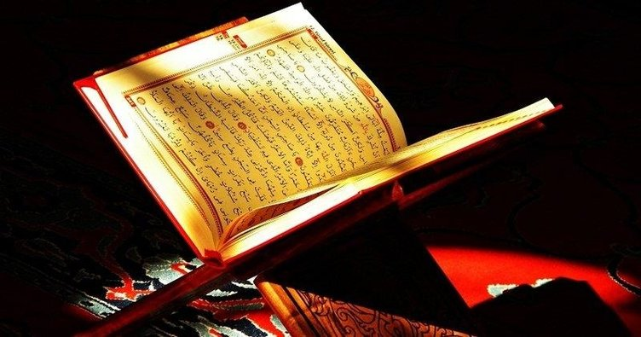

Slide 5
Islam means submission
obeying and being in peace.

Slide 6
Islam is to surrender to Allah
to adopt and demonstrate the religions principles of the last prophet Mohammed.

Slide 7
Islam is the religion of peace.
In the Quran .If a person kills a person unjustly, he kills all human beings. One who saves a person’s life will make the whole world and humanity alive.

Slide 8
Muslim is called to anyone who believes in Islam.
The Holy Quran is the holy book of Muslims.

Slide 9
Their places of worship are mosques.
Muslims return to ‘Kaabe’ in Mecca during praying.

Slide 10
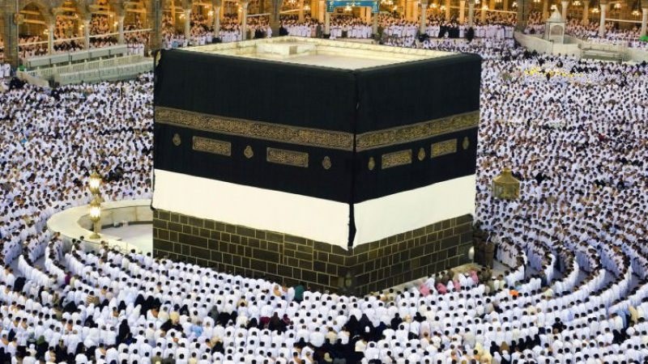

Slide 11
Islam is the religion of Tawheed.
It means the essence of Islam and it is the belief in one God;
This is called the belief of monotheism.

Slide 12
The first message of Mohammed our prophet was that :
“Do not serve other than Allah”

Slide 13
Islam gives importance to wisdom.
Mind distinguishes between good and bad.

Slide 14
Muslims worship 5 times a day.
Imams are our religious figures.
At certain hours in a day they come up the Minaret in the mosques call for praying.It is called “ezan” .

Slide 15
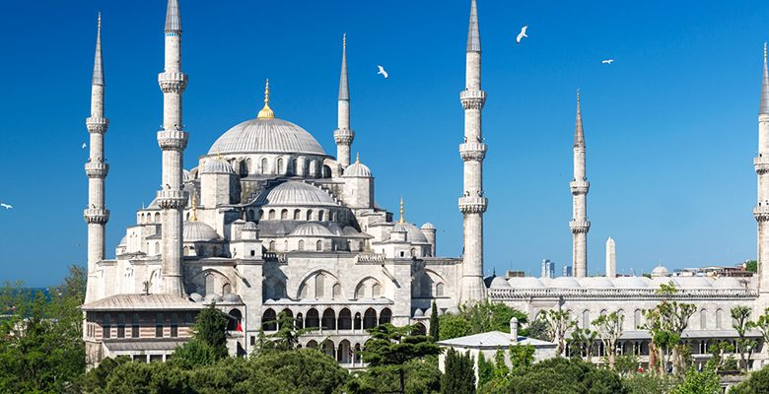

Slide 16
Before we turn ourselves to God for worship.We have to perform an ablution.
Ablution means we have to clean our face, hand , head and foot before praying.

Slide 17
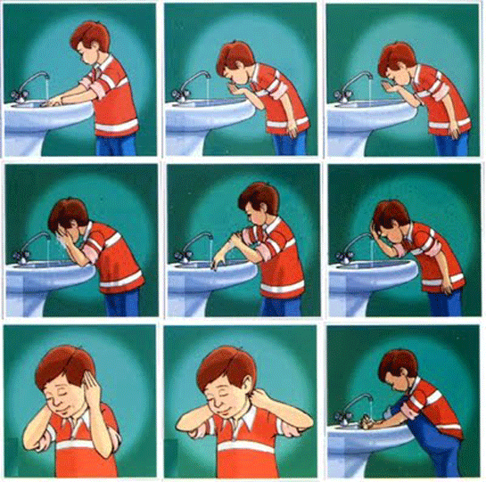

Slide 18
The terms of faith in Islam are 6. And these are:

Slide 19
Islam is the religion of love. In Quran it says that we must love each other , all living things like plants, animals because God created all the things.

Slide 20
Before we turn ourselves to God for worship.We have to perform an ablution.
Ablution means we have to clean our face, hand , head and foot before praying.

Slide 21
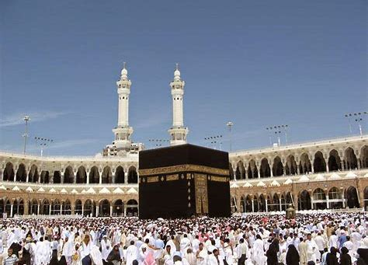
1-Believe that Allah is the one and unique

Slide 22
2-Believe in Angels

Slide 23
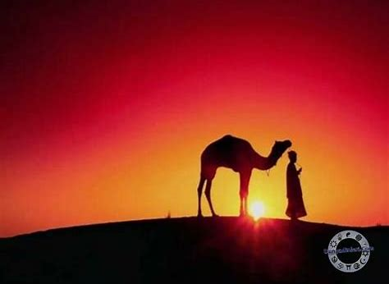
3-Believe in the Prophets

Slide 24
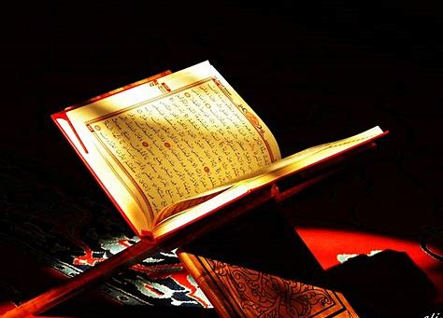
4-Believe in the books like Bible, Torah sent by Allah.

Slide 25
5-Believe in faith
6- Believe in the existence of here after.

