Slide 1
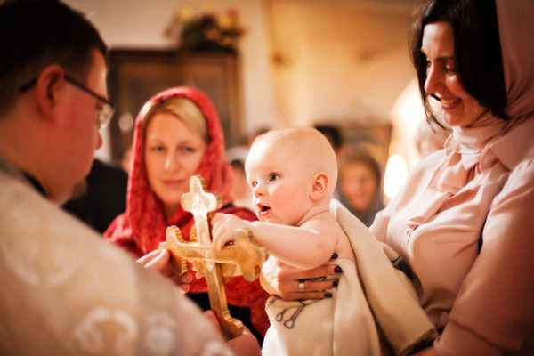
Religious confessions in Romania
Romania is a secular state, and it has no state religion.
The Eastern Orthodox Church
includes 81.04% of people.

Slide 2
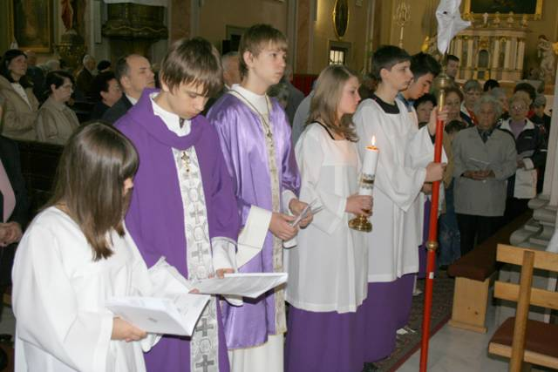
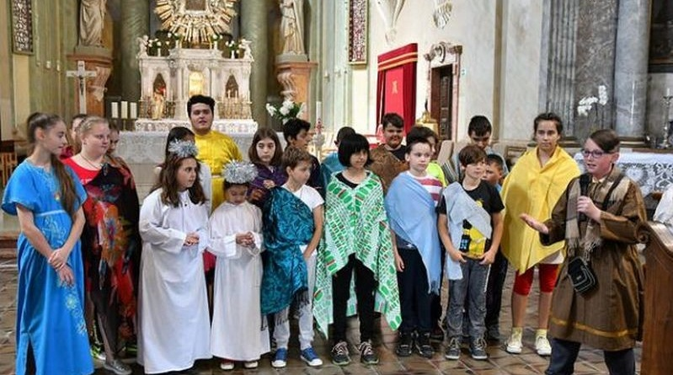
Other Christian
denominations
include
The Roman Catholic Church - 4,62%
❖ The Greek Catholic Church- 0.8%

Slide 3
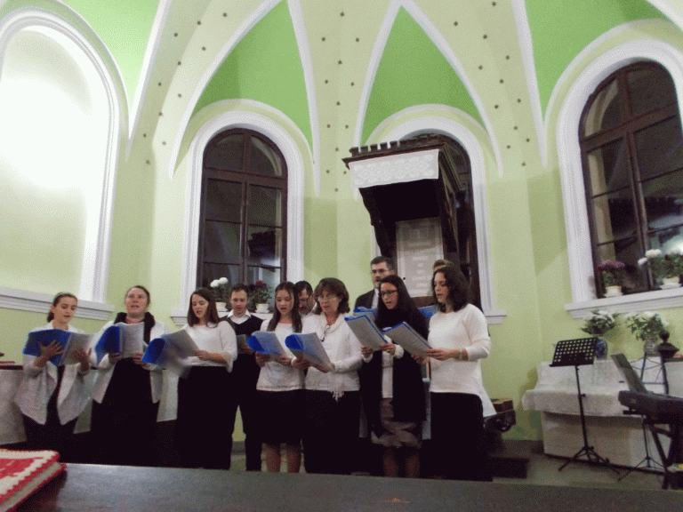
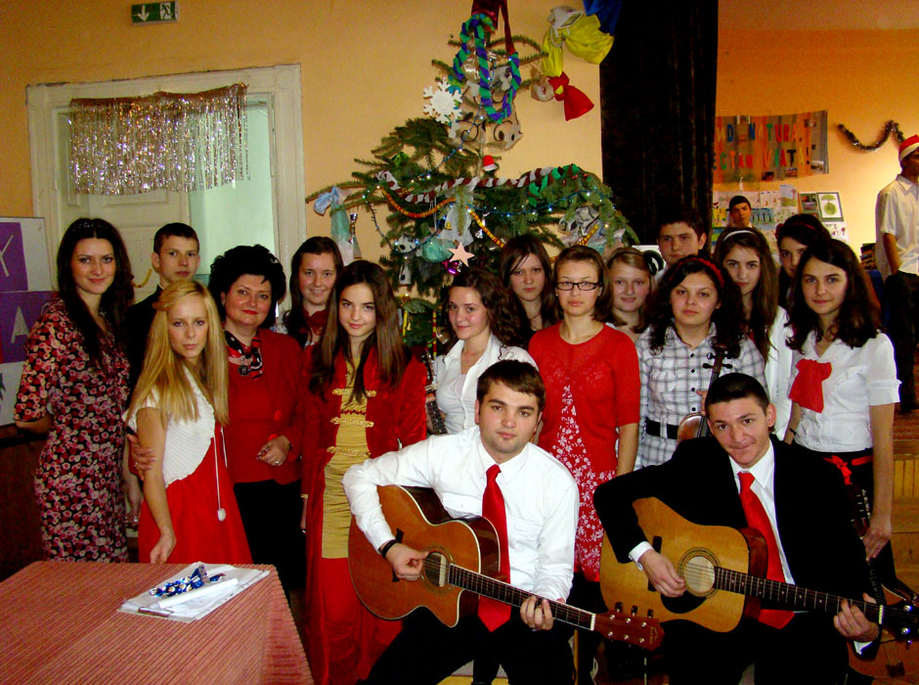
❖ Calvinism - 2.99%
❖ Pentecostal denominations -1.80%.

Slide 4
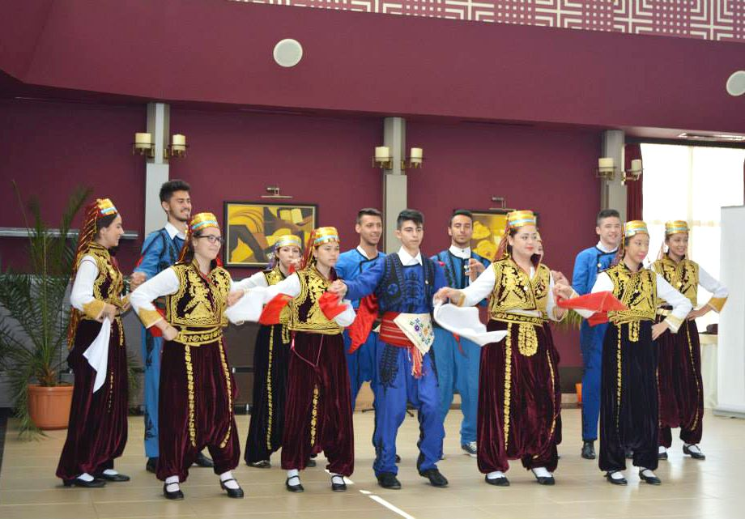
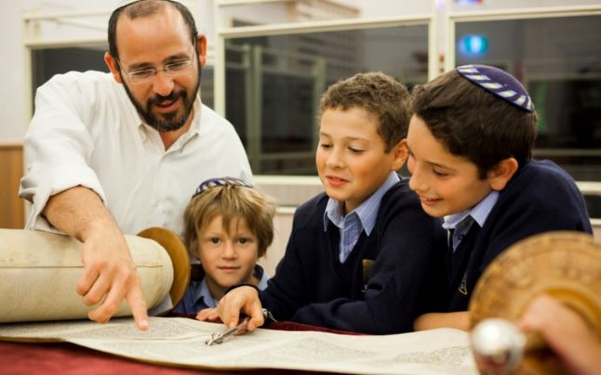
Romania also has a small but historically significant
Muslim minority
❖ There are also approximately 3,500 Jews.
There are around 21,000 atheists and about 19,000 people not identifying with any religion.

Slide 5
The Romanian state officially recognizes 18 religions and denominations.
❖ Romanian Orthodox Church
❖ Serbian Orthodox Diocese of Timisoara
❖ The Roman Catholic Church
❖ The Greek Catholic
❖ The Armenian Church
❖ Old Rite Orthodox Church
❖ The Reformed Church
❖ The Evangelical Church C.A.
❖ The Lutheran Evangelical Church
❖ The Hungarian Unitarian Church
❖ The Baptist Christian Cult - Union of Christian Baptist Churches in Romania
❖ The Christian Church After the Gospel
❖ The Romanian Evangelical Church
❖ Pentecostal Christian Cult - The Church of Apostolic God
❖ Seventh-day Adventist Church in Romania
❖ Federation of Jewish Communities - Mosaic Cult
❖ Muslim cult
❖ Religious Organization "Jehovah's Witnesses“

