Slide 1
dr. France Prešeren
The Unmarried Mother

Slide 2
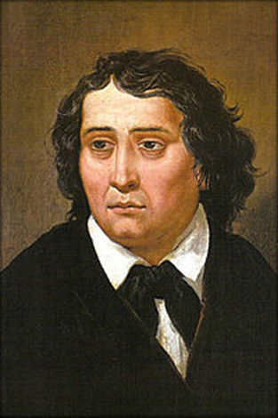
Who was this very important Slovenian man?

Slide 3
LIFE
the greatest Slovenian poet
his poem A Toast (Zdravljica) - our national anthem:
Prešeren's belief that the main aim of each nation is to achieve freedom, independence and equality
no wars between the nations, but friendship and connection
19th century
many poems, sonnets, ballads and romances, gazelles – translated into many European languages

Slide 4
The poem - audio

Slide 5
What is the poem about?
How does the mother feel?

Slide 6
VOCABULARY
foolish
to curse
to entreat
to blush
on the sly
to wander
shamed
to suffer
joy
to shed
In groups find the meanings / descriptions of the words or phrases.

Slide 7
QUESTIONS ABOUT THE POEM
Who is the mother talking to?
What is her problem?
How does she feel about her situation?
How did the people react to her situation?
Where is the father of the child?
How does the father feel about his child?
How does the mother feel about her child?
What is a reward for her suffering?

Slide 9
RESOURCES
Resource 1
Resource 2
Resource 3
Resource 4
Resource 5

