Slide 1
THE LIFE OF NASRETTİN HOCA

Slide 2
Nasrettin Hoca was born in Sivrihisar, Eskişehir in 1208. His father was Abdullah Efendi and his mother was Sıdıka Hatun.

Slide 3
He was a folk scholar. He was known for not just in Anatolia in other Turkish communities. He was known as Mullah Nasrettin in Azerbaijan,Hoca Nasrettin in Kazakhstan and Nasrettin Efendi in Uzbekistan

Slide 4
There are about 300 jokes in his life.They make you think and laugh .
EXAMPLE:
They asked Hoca, “Sir,in the morning some people go this way and some go the opposite way. Why?”
Hoca answered, “If they went in the same direction, the Earth would loose its balance and toople.”

Slide 5
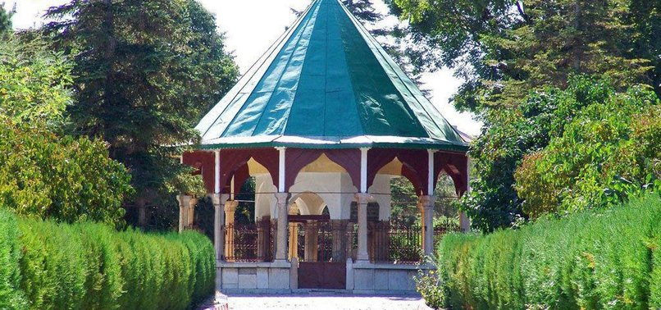
He died in Akşehir,Konya in 1284. And now he is in Nasrettin Hoca Tomb in Konya.

