Slide 1
DROWSY BIRDS by Mihai Eminescu
1884

Slide 2
Mihai Eminescu (1850 - 1889) is regarded as the greatest and the most famous Romanian poet. His life, work and poetry strongly influenced the Romanian culture.
His poems are widely studied in Romanian schools and have been translated in over 60 languages.

Slide 3
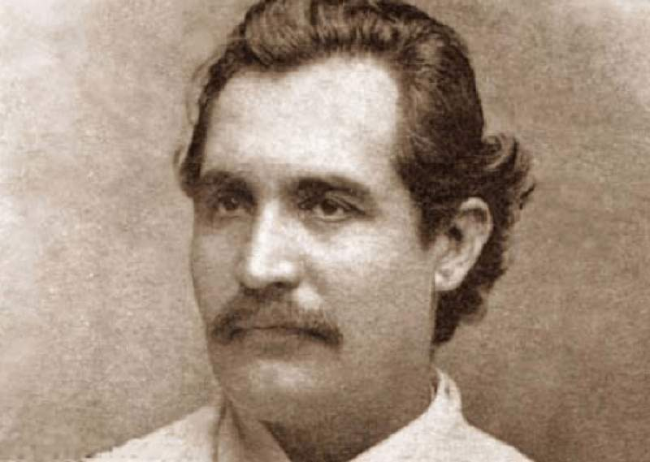
Mihai Eminescu was a Romantic poet, novelist and journalist.
His untimely death and his bohemian lifestyle (he never pursued a degree, a position, a wife or fortune) had associated him with the Romantic figure of the genius.
His poetry was
first published
when he was 16.

Slide 4
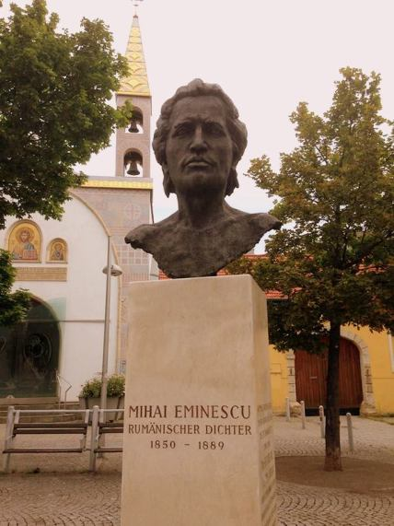
Mihai Eminescu’s Statues across Europe
Switzerland
Germany

Slide 5
Eminescu's Linden Tree is one of the country's most famous natural landmarks and it is in Iasi. Just imagine, a linden tree that is 150 years old! You need more than 3 men to hold hands around it.

Slide 6
His poems have a wide range of themes:
nature
childhood years
love
hate
social commentary

Slide 7
He frequently used:
metaphysical
mythological
historical subjects
He enriched the literary language with words and phrases from all Romanian regions, from old texts, and with new words that he coined from his wide philosophical readings.

Slide 8
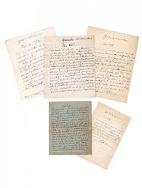
Notable works include
What I wish for you,
sweet Romania
The Evening Star
The Five Letters

Slide 9
Somnoroase păsărele
Drowsy Birds…

Slide 10
Drowsy birds are seeking rest
Swarming to’ards the trees in flight
‘Mong the brances make their nest Hush, good night!
Only springs are sighing deep,
Silence rules the night-black wood;
Even gardens are asleep –
Peace is good!
Swans are sailing on the lake
Seeking shelter’mong the rush –
May your angels keep awake!
Sleep, hush, hush!
Over night’s charmed fairy tale
Proudly does the moon shed light;
Dreams and harmony prevail, --
So, good night!
Somnoroase păsărele Pe la cuiburi se adună, Se ascund în rămurele – Noapte bună!
Doar izvoarele suspină, Pe când codrul negru tace; Dorm şi florile’n grădină – Dormi în pace!
Trece lebăda pe ape Între trestii să se culce – Fie-ţi îngerii aproape, Somnul dulce!
Peste-a nopţii feerie Se ridică mândra lună, Totu-i vis şi armonie – Noapte bună!

Slide 11
There are 4 stanzas
Each stanza is made up of:
three verses of eight syllables
one verse of three syllables.
NB! The translated version has only 7 (seven) syllables, due to translation reasons

Slide 12
Syllables
1 2 3 4 5 6 7
Drow – sy – birds – are – see – king - rest,
1 2 3 4 5 6 7
Swar – ming – to;ards – the – trees – in - flight
1 2 3 4 5 6 7
‘Mong – the – bran – ches – make – their – nest
1 2 3
Hush, - good - night!

Slide 13
Rhyme
Drowsy birds are seeking rest
Swarming to’ards the trees in flight
‘Mong the brances make their nest Hush, good night!
ABAB end rhyme

Slide 14
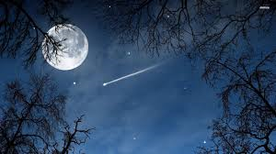
Each stanza ends with a formula that is commonly said before bedtime:
“Hush, good night!”
“Peace is good!”
“Sleep, hush, hush!”
“So, good night!”

Slide 15
The use of the personal pronoun in the second person singular suggests that the work is actually a bedtime poem for a dear person. The use is in the Romanian version of the poem.

Slide 16
Figures of speech
Epithets
Personifications
Repetitions
Metaphors

Slide 17
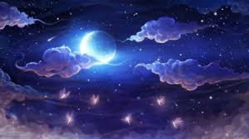
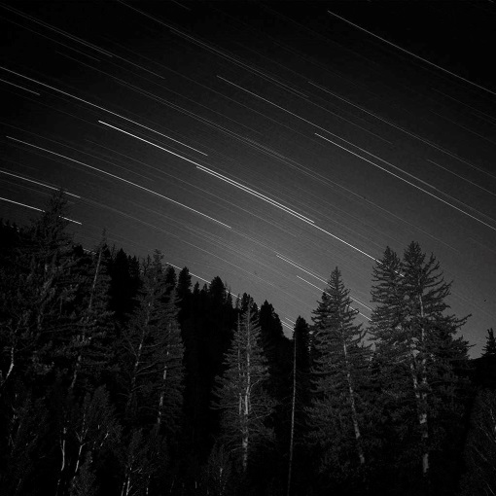
Epithets
“drowsy birds”
“night’s charmed fairy tale”
“night black-wood”

Slide 18
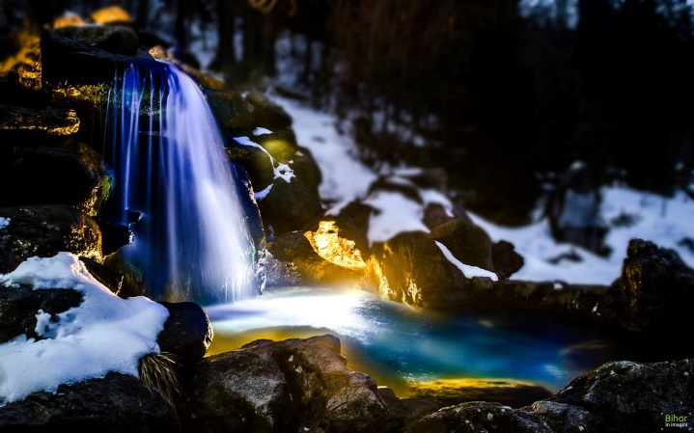
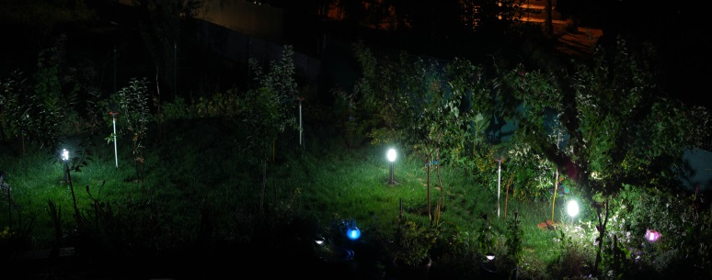
Personifications
“springs are sighing deep”
“gardens are asleep”

Slide 19
Repetitions
“hush, hush”…
“Good night!”

Slide 20
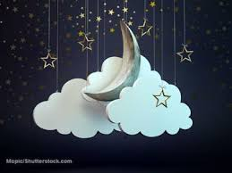
Metaphors
Over night’s charmed fairy tale
Proudly does the moon shed light;
Dreams and harmony prevail, --
So, good night!

Slide 21
Thank you!

