Slide 1
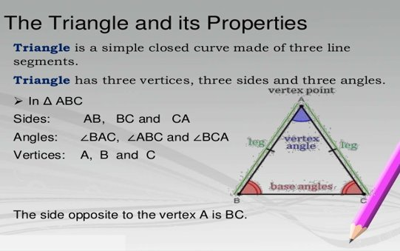
Let's get familiar with triangles...

Slide 2
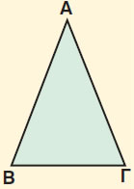
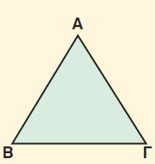
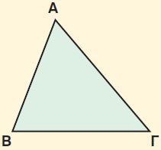
Notice the sides!!!
Isosceles
triangle
Equilateral triangle
Scalene triangle

Slide 3
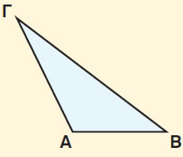
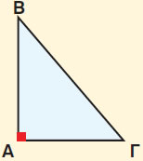
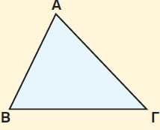
Notice the angles!!!
Obtuse triangle
Right triangle
Acute triangle

Slide 4
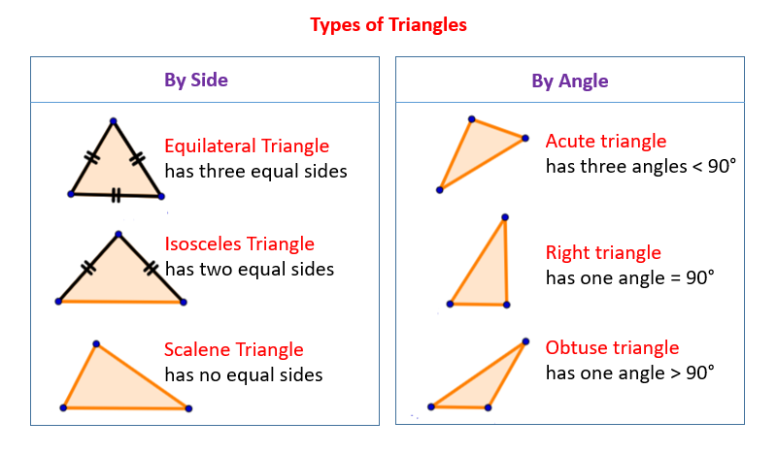
Now it's time to learn...

Slide 5
Can you draw a specific type of triangle?
Follow the link if you dare!

Slide 6
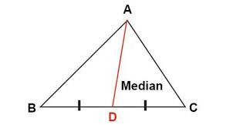
Some extra parts of the triangles
A median in a triangle is the line segment drawn from a vertex to the midpoint of its opposite side.

Slide 7
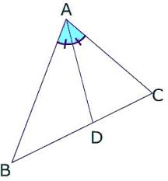
Some extra parts of the triangles
An angle bisector in a triangle is a segment drawn from a vertex that bisects (cuts in half) that vertex angle.

Slide 8
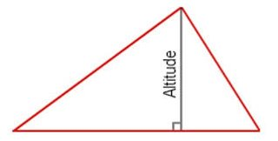
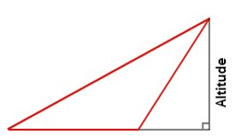
Some extra parts of the triangles
An altitude in a triangle is the perpendicular segment from a vertex to its opposite side (or the extension of the opposite side).

Slide 9
Can you draw these segments in a triangle?
Follow the link to explore the medians, angle bisectors and altitudes!

Slide 10
Let's see what we learn?
Quiz 1 Quiz 2

