Slide 1
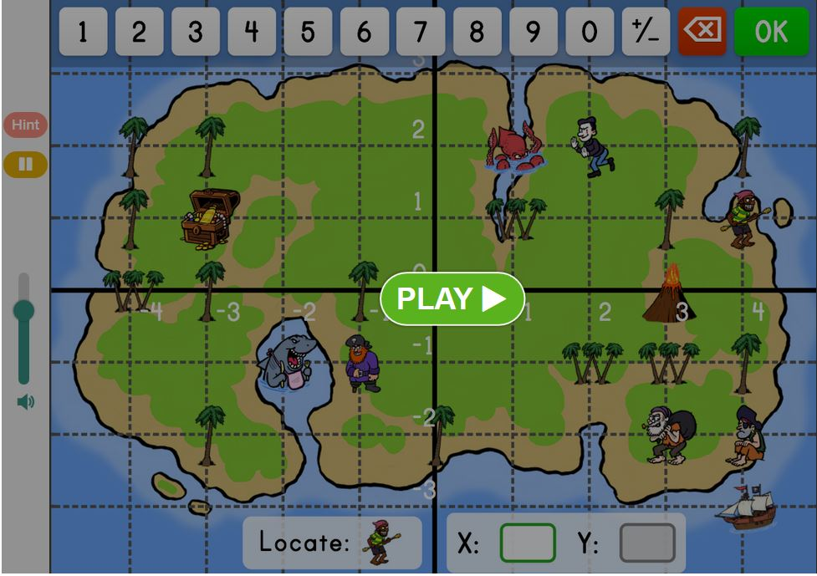
WHERE DO I NEED IT?
Playing games, navigation,…
Example:
https://www.education.com/game/treasure-map-graphing/

Slide 2
COORDINATE SISTEM IN MATH
two right angles lines:
a horizontal line – x – axis,
a vertical line –
y – axis
the axis intersect at a point called the origin
the y - axis
the x - axis
the origin

Slide 3
How to mark the coordinate system?

Slide 6
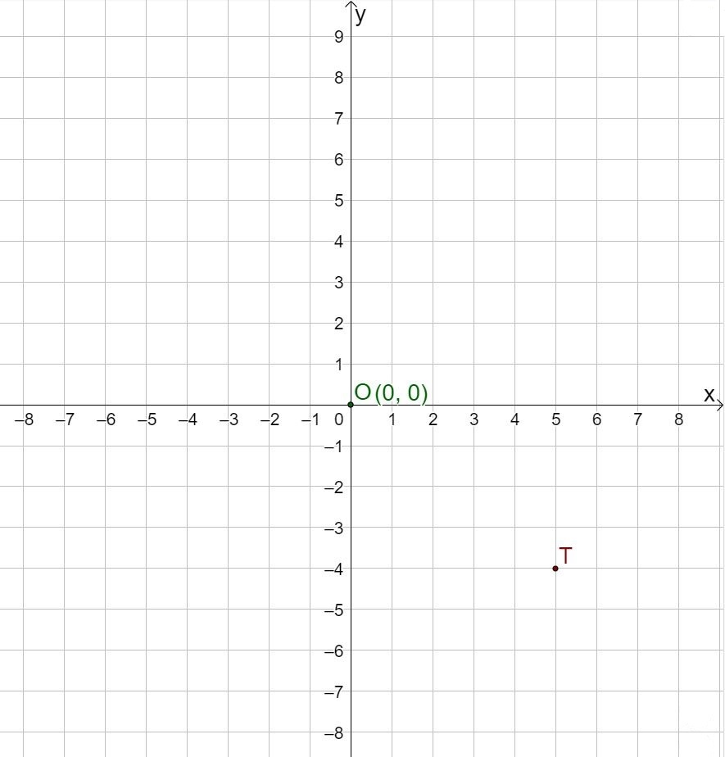
How to move around the coordinate system?
we always start in the
origin with coordinates (0,o)
O (0,0)
An ordered pair contains
the coordinates of one point in the coordinate system.
A point is named by its ordered pair of the form of
T (x, y).
The first number corresponds to the x-coordinate and the second to the y-coordinate.

Slide 7
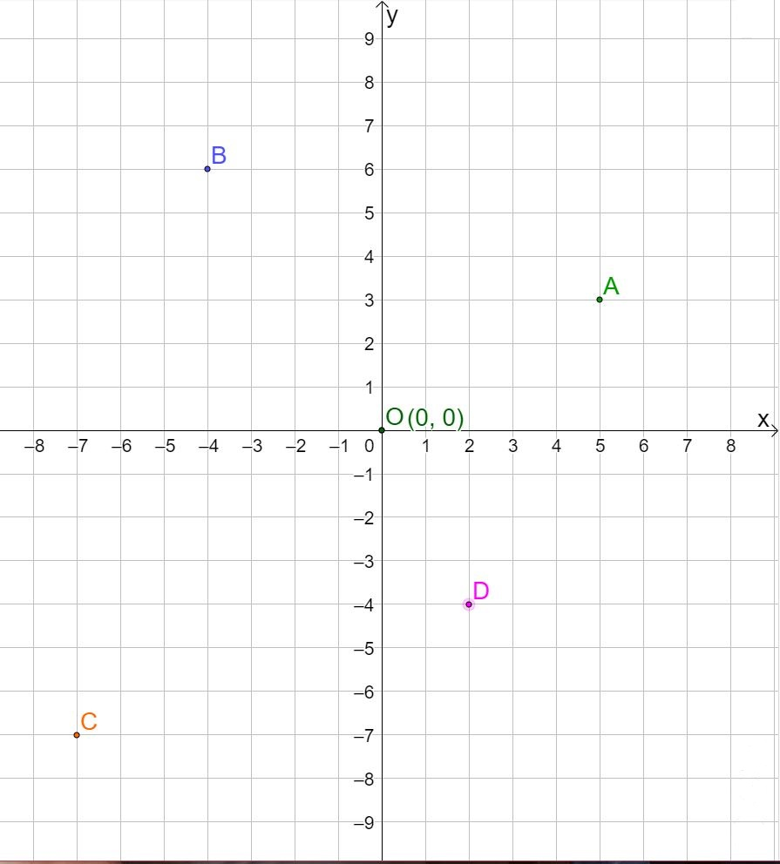
(-4,6)
(5,3)
(2,-4)
(-7,-7)

Slide 8
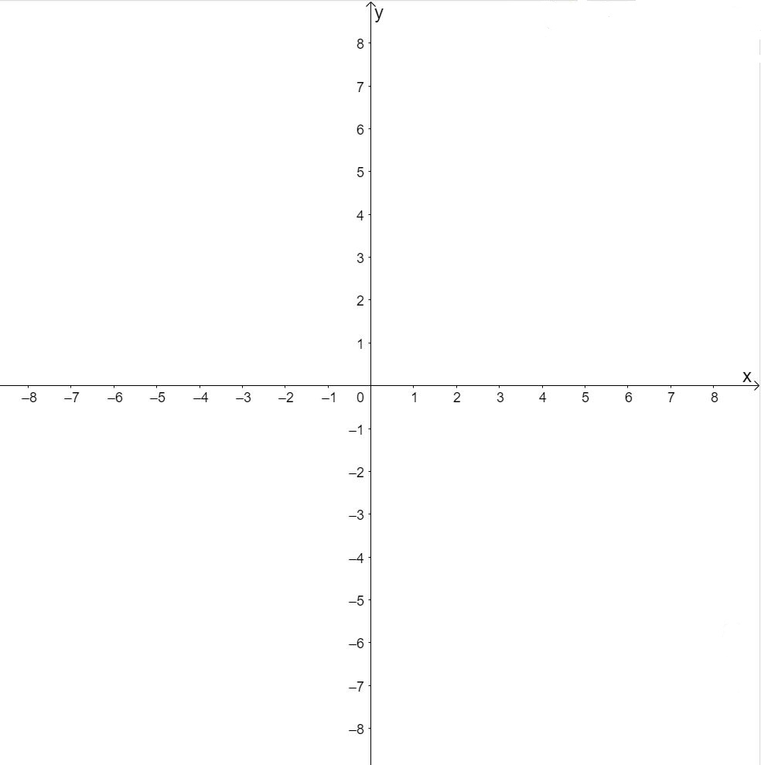
Let's try!
1. a) Plan a coordinate system and mark it!

Slide 9
b) Find the points
S(-5,7), M(-2,0), I(0,4), L(3,1) and E(6,-3).

